Slide 1
Data Driven AI
Week 9 – Convolutional Neural Network (CNN) Models-Part2
Dr. Abirami Gunasekaran
CHS2406: Data-driven AI

Slide 2
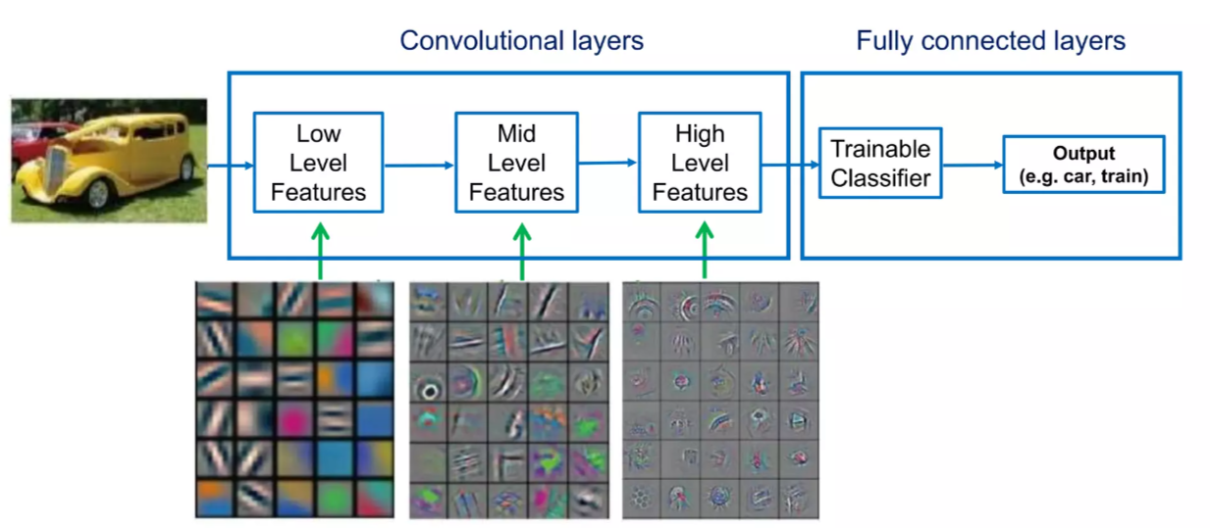
Recap: CNN – What do they Learn?

Slide 3
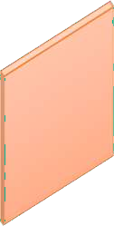
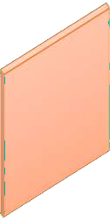



Recap:Feature Map Transformation
𝒎𝒂𝒙(𝟎, 𝒘^{𝑇}𝒙_{𝑖,𝑗} + 𝑏)
𝒘^{𝑇}𝒙_{𝑖,𝑗} + 𝑏
K=3,S=1, P=1
32x32x3
32x32
32x32
Convolution is a linear operator
Apply an element-wise nonlinearity to obtain a transformed feature map

Slide 4
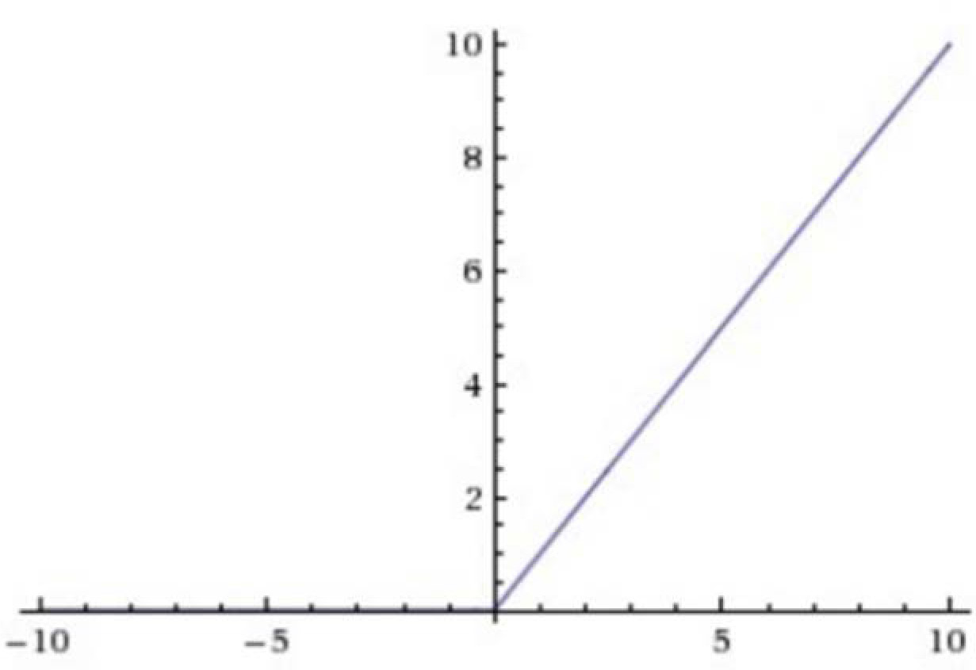
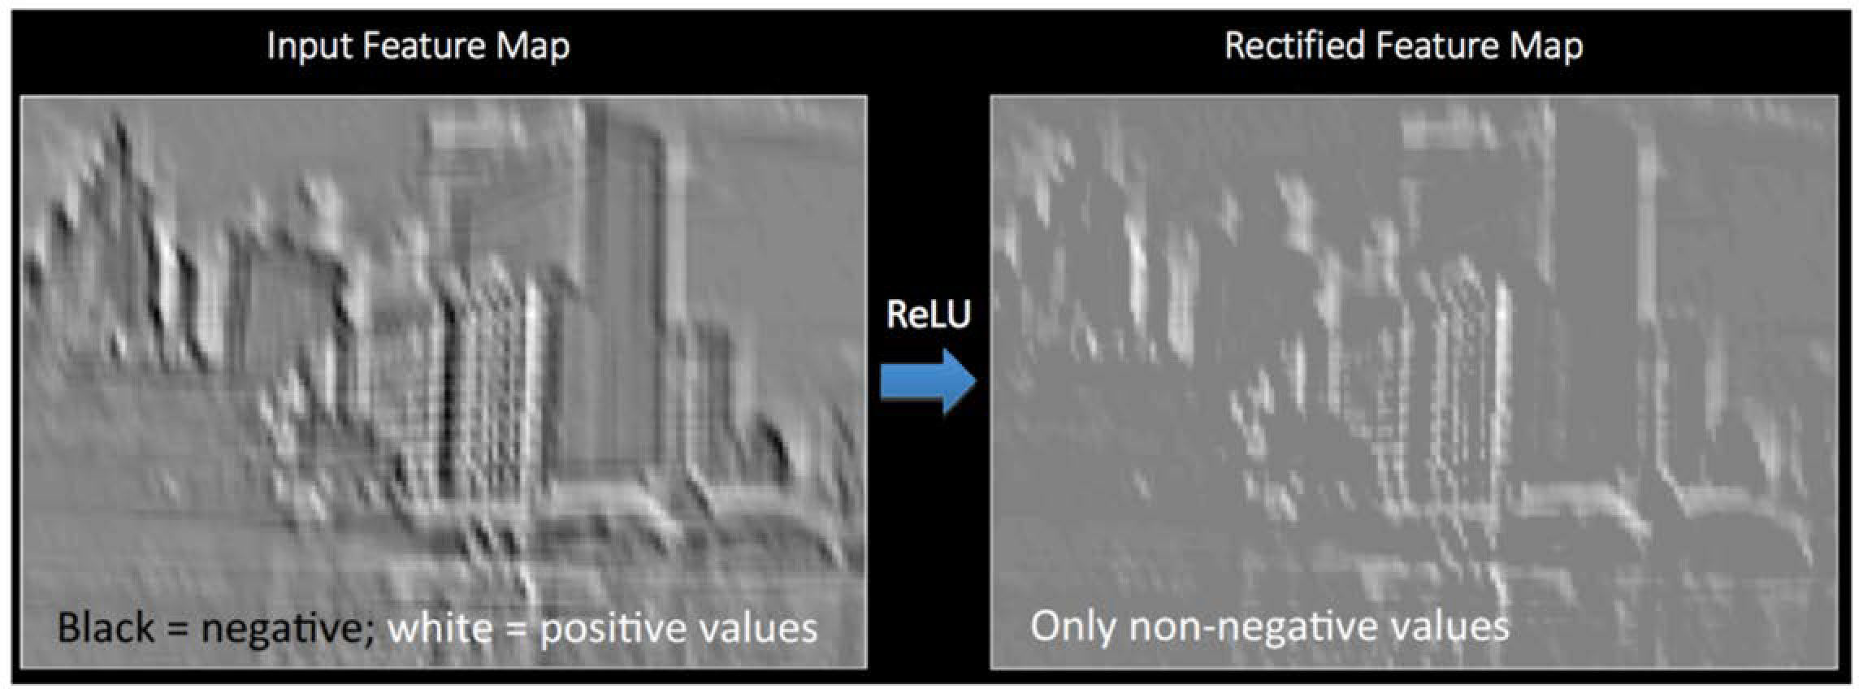
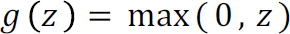
Recap: Introducing Non-Linearity
- Apply after every convolution operation
(i.e., after convolutional layers)
ReLU: pixel-by-pixel operation that replaces all negative values by zero.
Non-linear operation
Rectified Linear Unit (ReLU)
tf.keras.layers.ReLU

Slide 5
Recap: Pooling
Operates on the feature map to make the representation
Smaller (subsampling)
Robust to (some) transformations
W=4
1 | 1 | 2 | 4
5 | 6 | 7 | 8
3 | 2 | 1 | 0
1 | 2 | 3 | 4
W’=2
Max pooling
1 | 8
3 | 4
H=4
H’=2
2x2 filters stride = 2
pooled map
feature map

Slide 6




Recap: The Convolutional Architecture
To next layer
An architecture made by a hierarchical composition of the basic elements
Convolution layer is an abstraction for the composition of the 3 basic operations
Network parameters are in the convolutional component
Convolutional layer
Pooling (max)
Nonlinearity (ReLu)
Convolutional Filters (Strided adaptive conv)
Input

Slide 7
Feature Extraction & Convolution- A Case Study

Slide 8
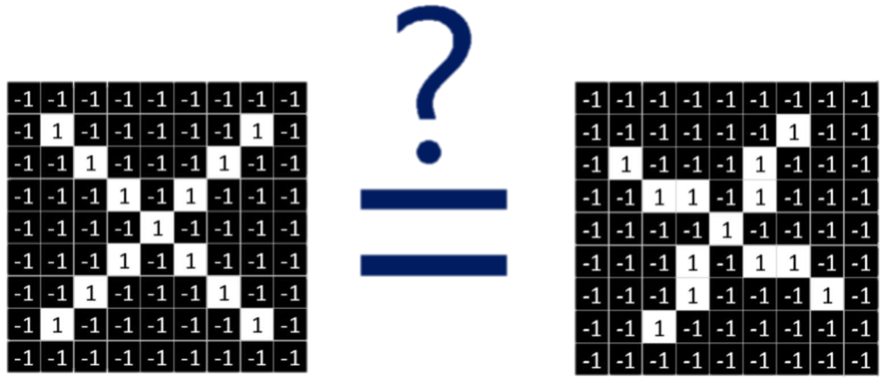
X or X?
Image is represented as matrix of pixel values… and computers are literal!
We want to be able to classify an X as an X even if it’s shifted, shrunk, rotated, deformed.

Slide 9
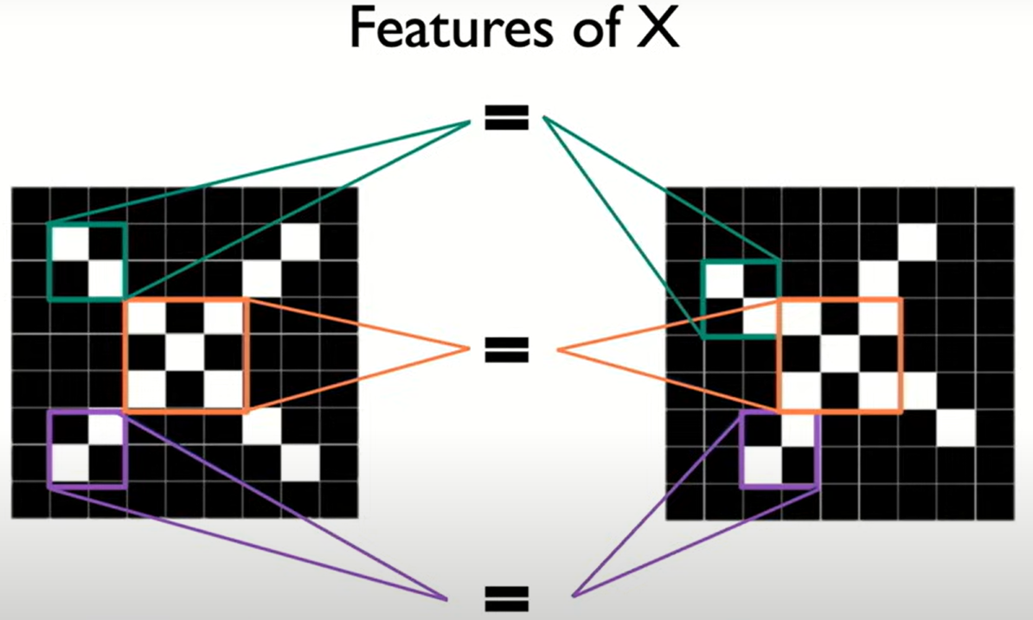

Slide 10
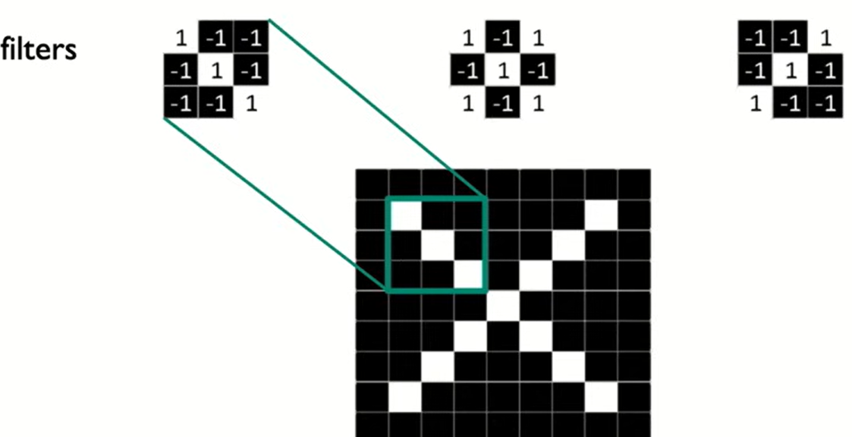

Slide 11
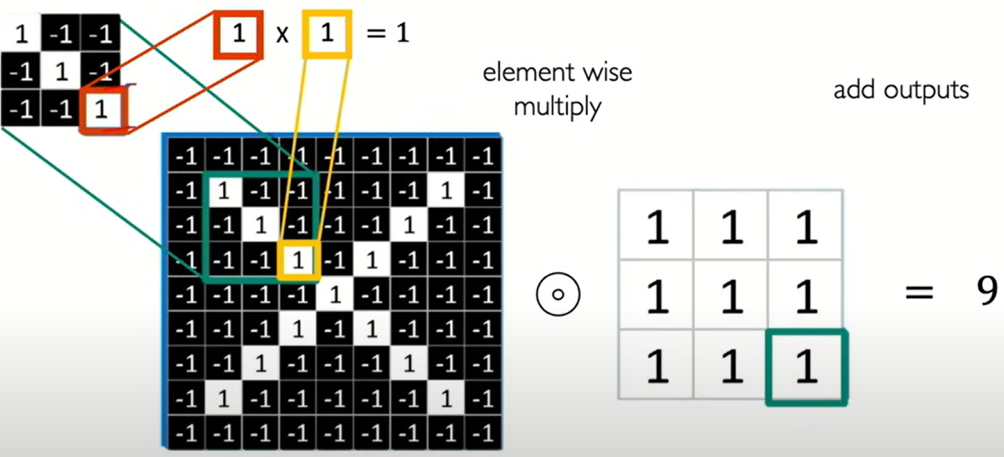
The Convolution Operation

Slide 12
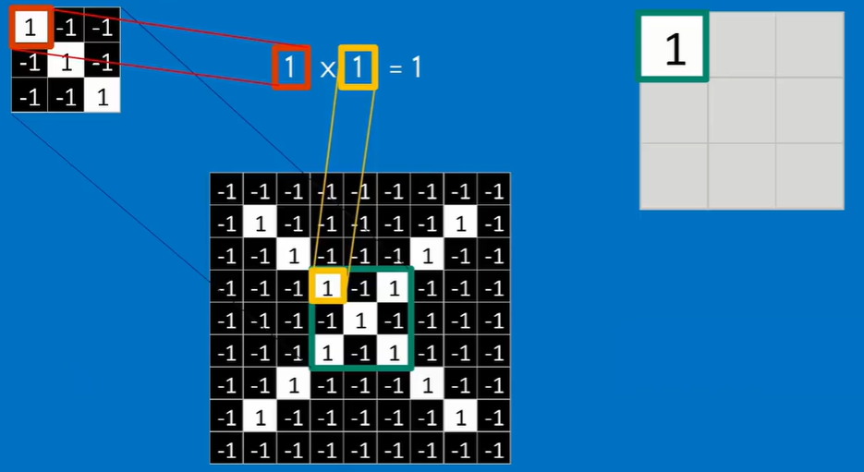
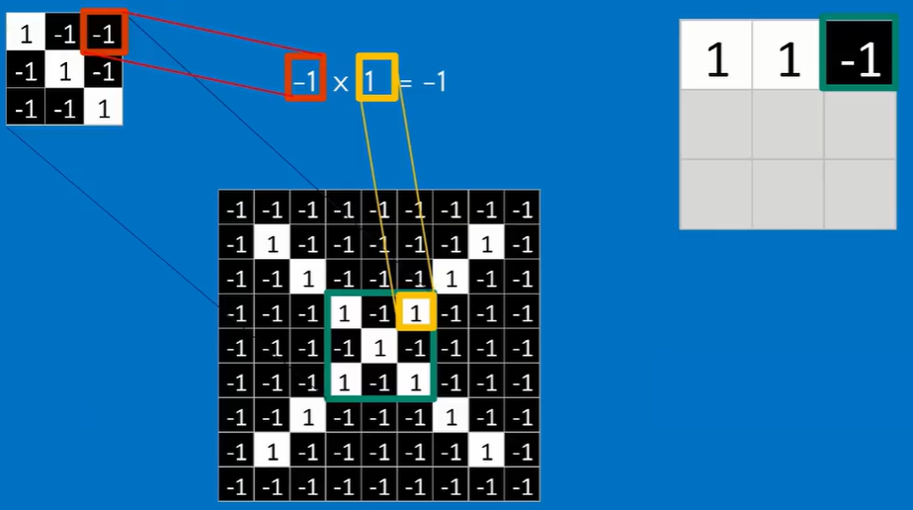
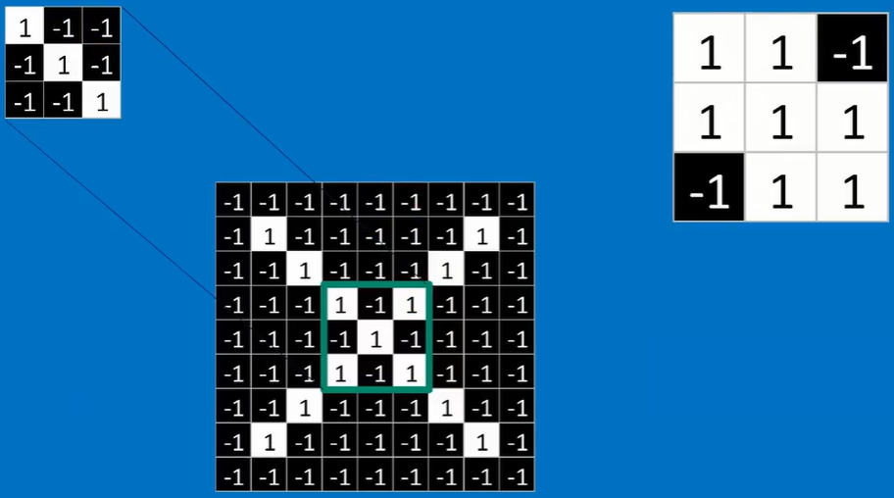
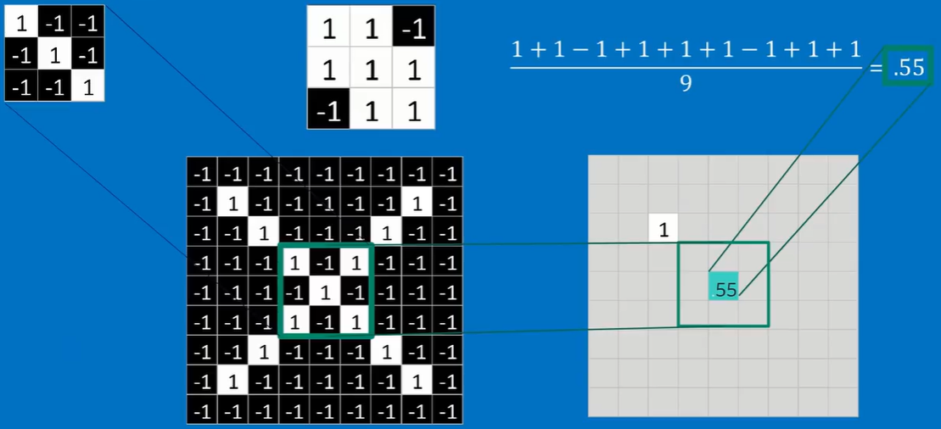
Convolution - Filtering

Slide 13
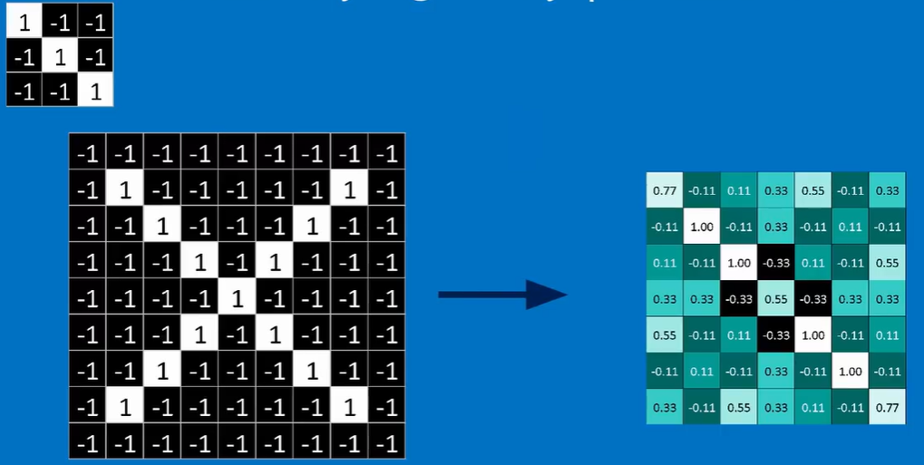
Convolution - Filtering

Slide 14
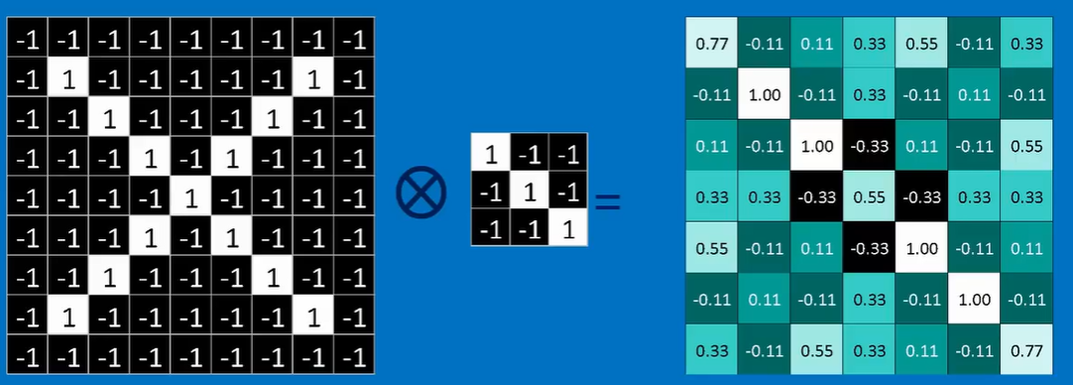
Filtered Image

Slide 15
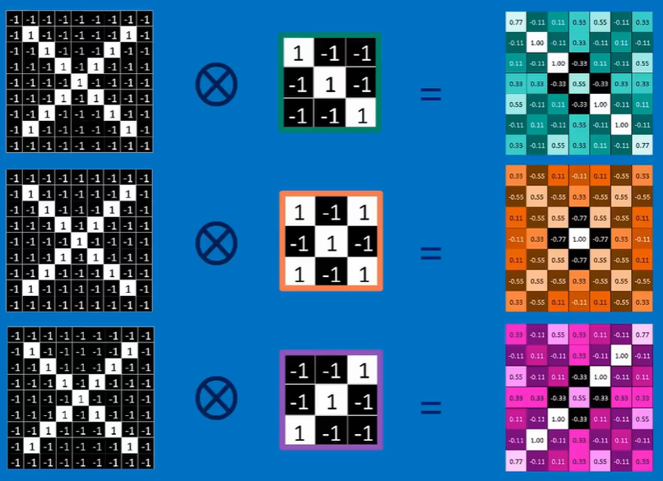
Stack of Filtered Images

Slide 16
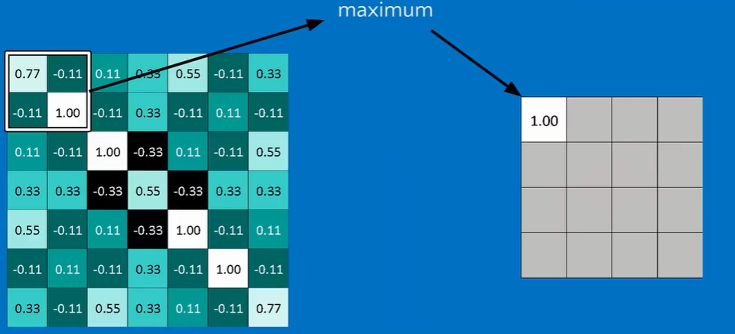
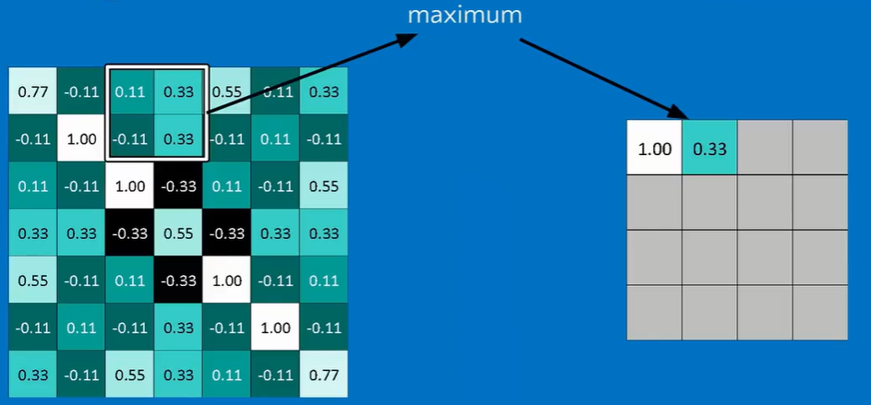
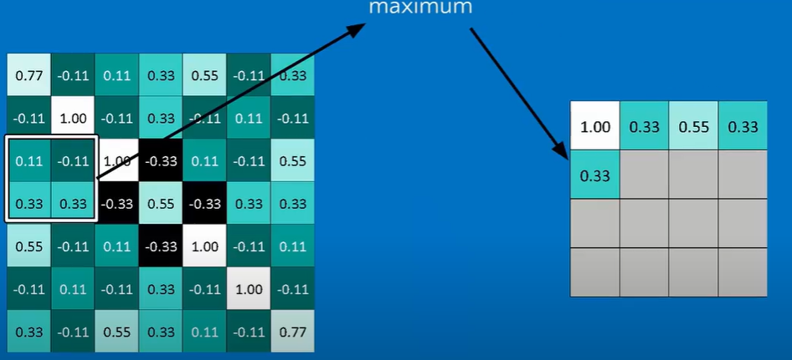
Max Pooling

Slide 17
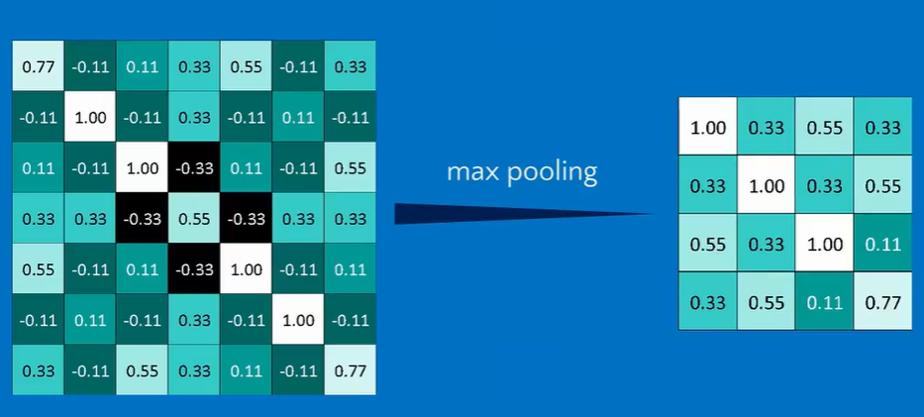
Max Pooling

Slide 18
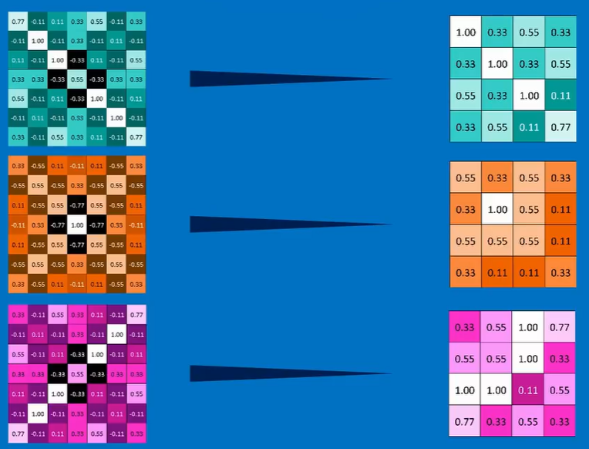
Max Pooling of Multiple Filtered Images

Slide 19
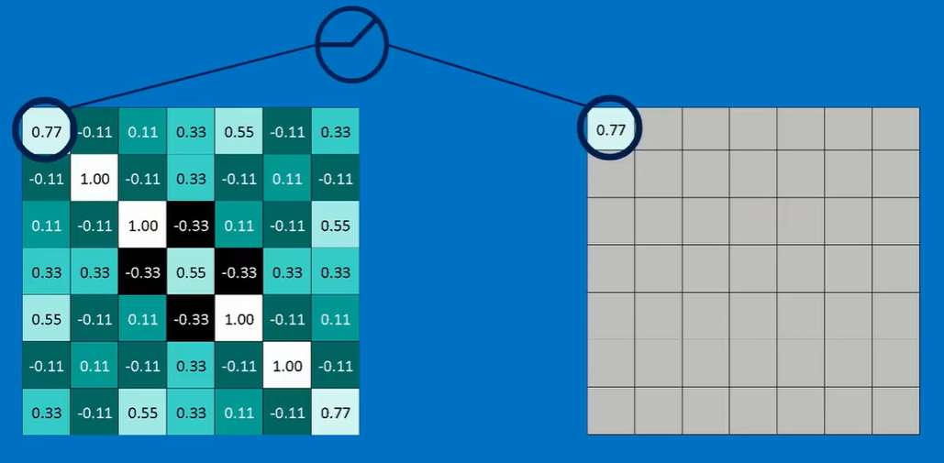
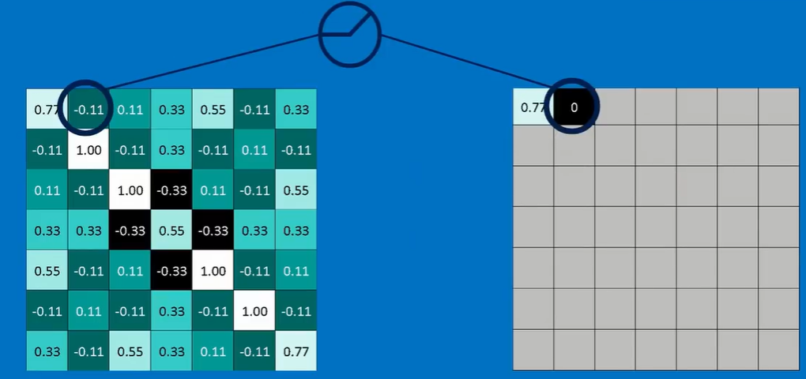
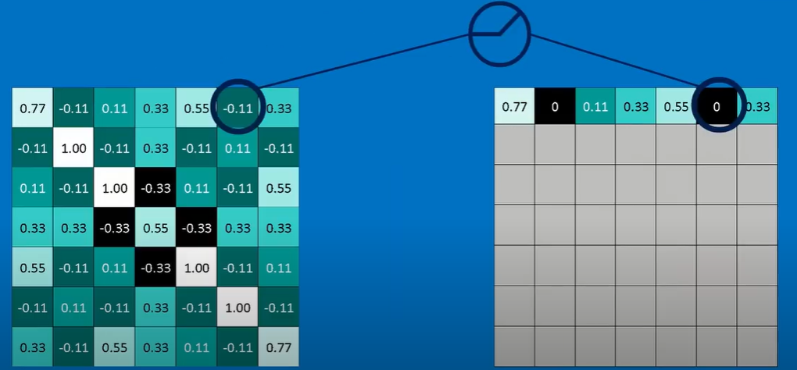
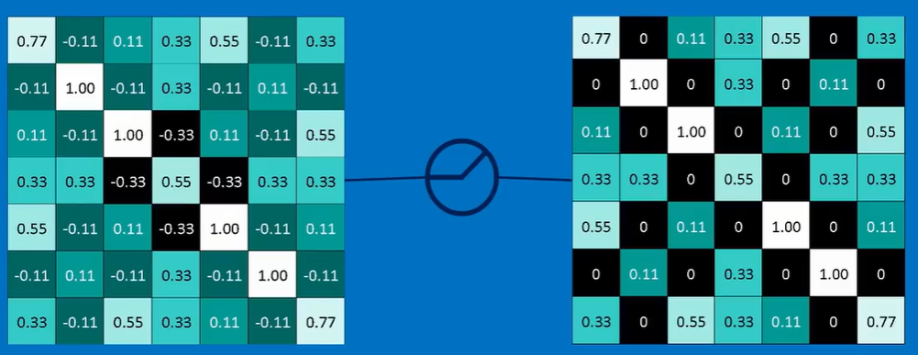
Non-Linear Activations - ReLU

Slide 20
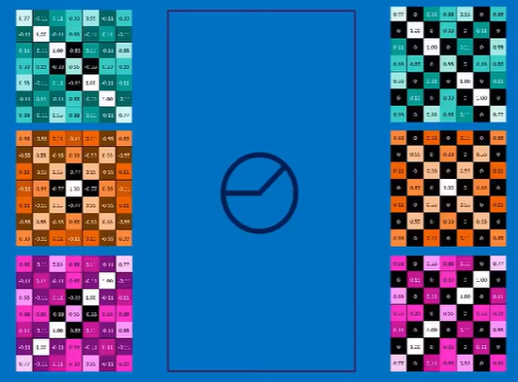
Non-Linear Activations - ReLU

Slide 21
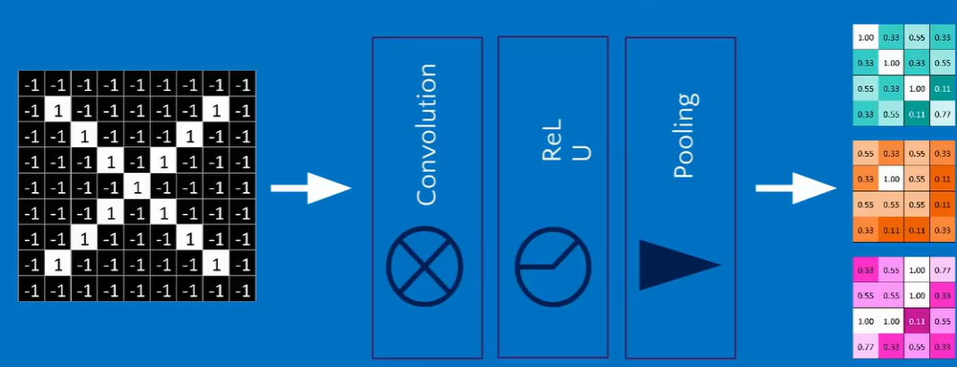
Stacked Layers

Slide 22
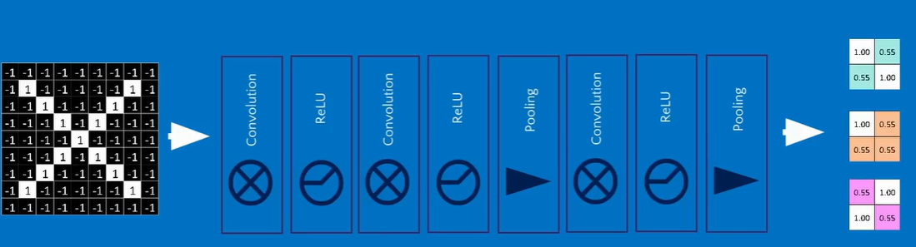
Deep Stacking

Slide 23
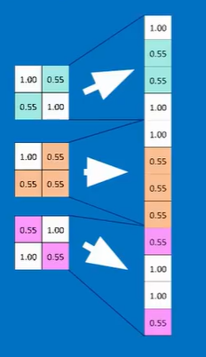
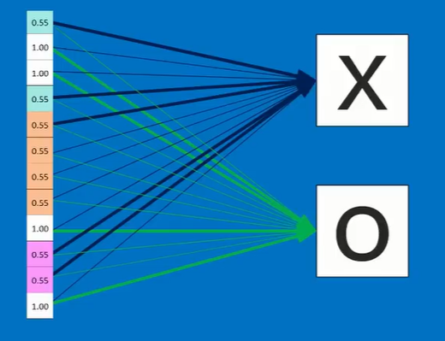
Fully Connected Layer

Slide 24
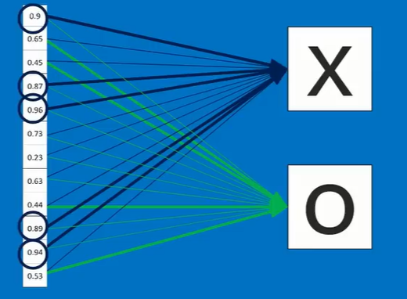
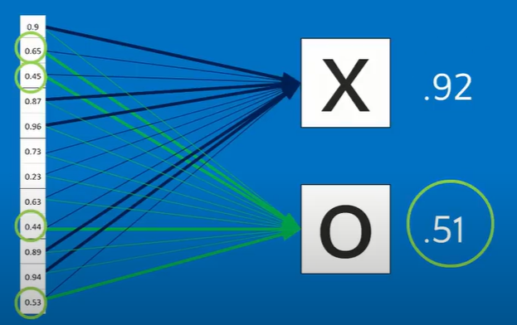
Weight Counting

Slide 25
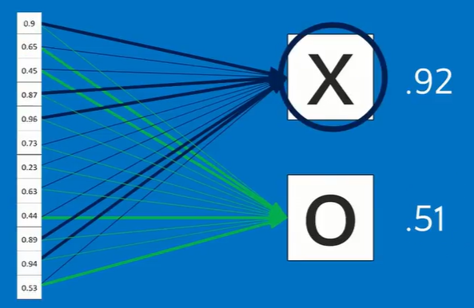
Target Class -Prediction

Slide 26
Countless Applications of CNN

Slide 27
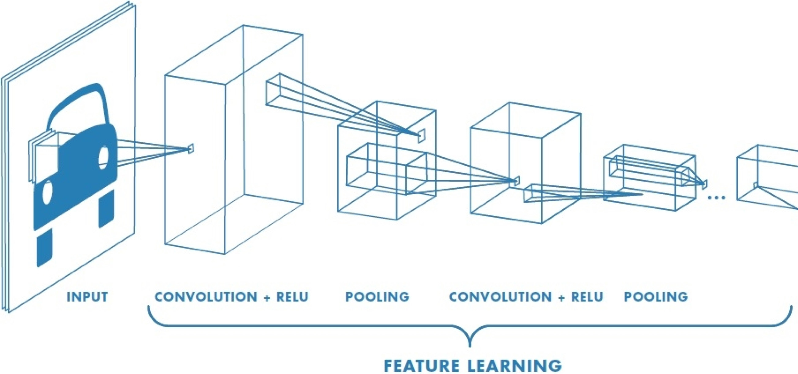
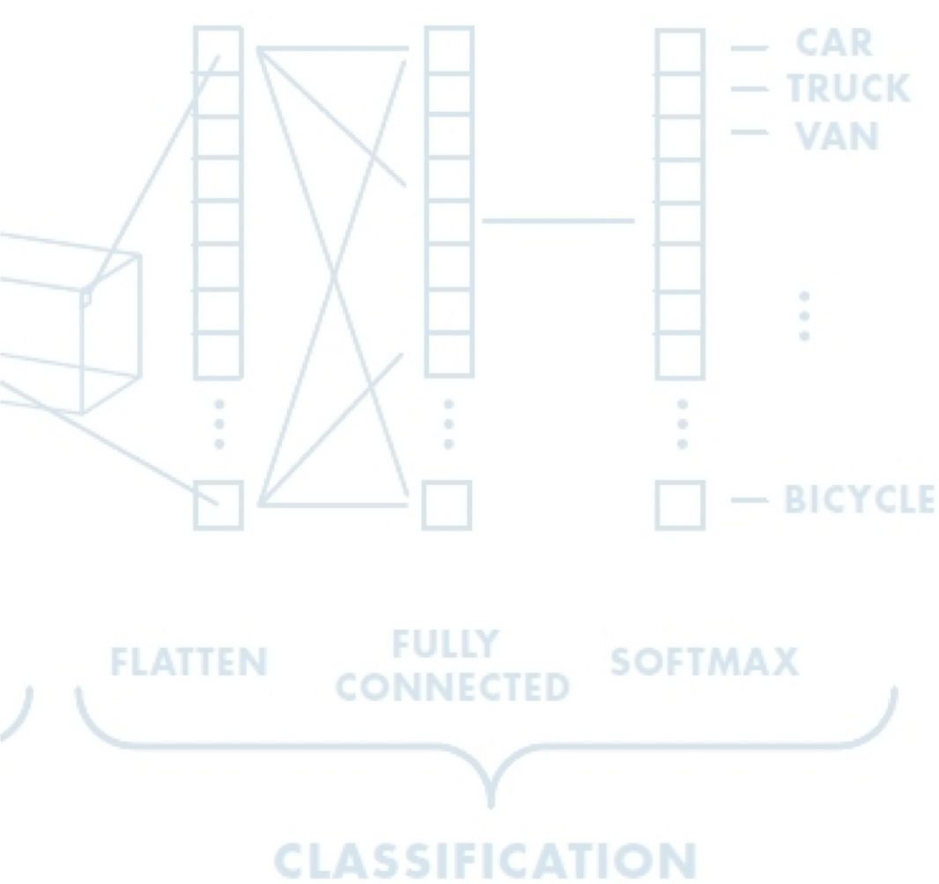
An Architecture for Many Applications
Detection Semantic segmentation End-to-end robotic control

Slide 28
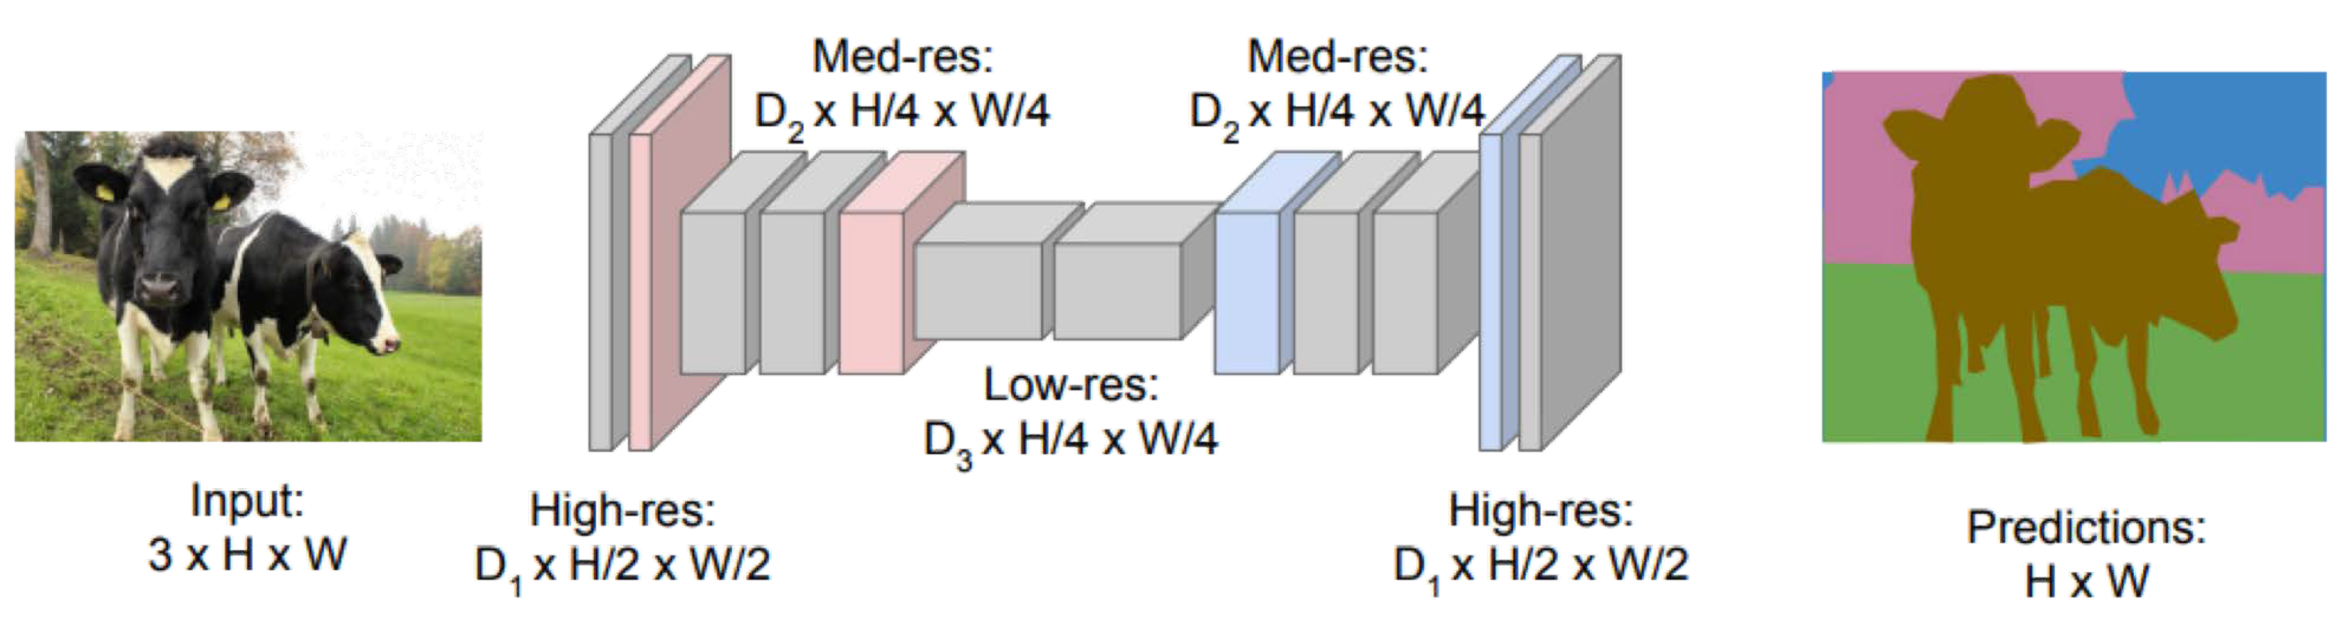

Semantic Segmentation: Fully Convolutional Networks
FCN: Fully Convolutional Network.
Network designed with all convolutional layers, with downsampling and
upsampling operations
tf.keras.layers.Conv2DTranspose
Long+ CVPR 2015

Slide 29
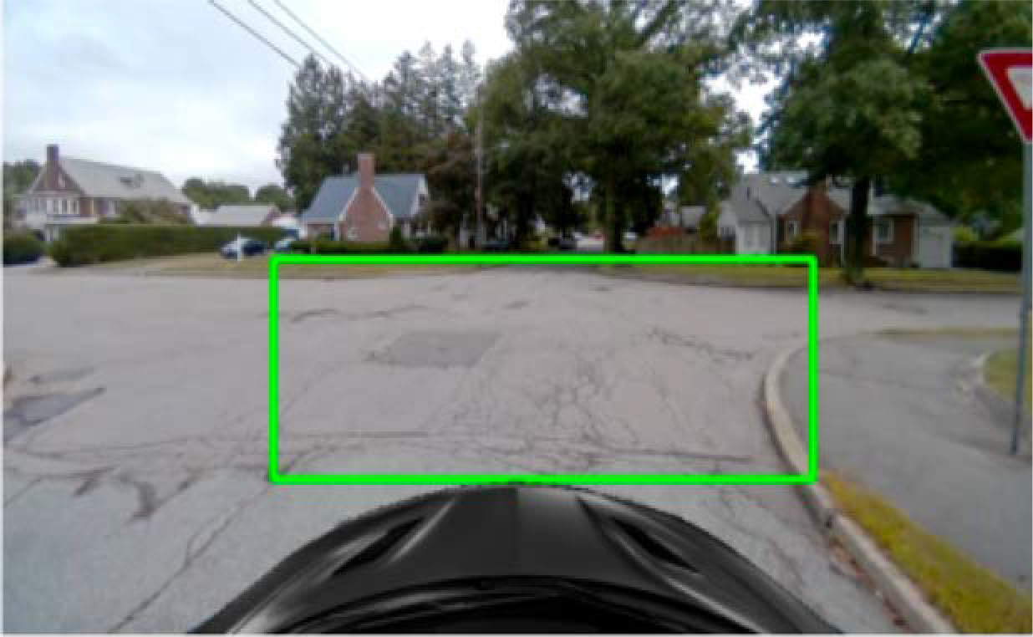
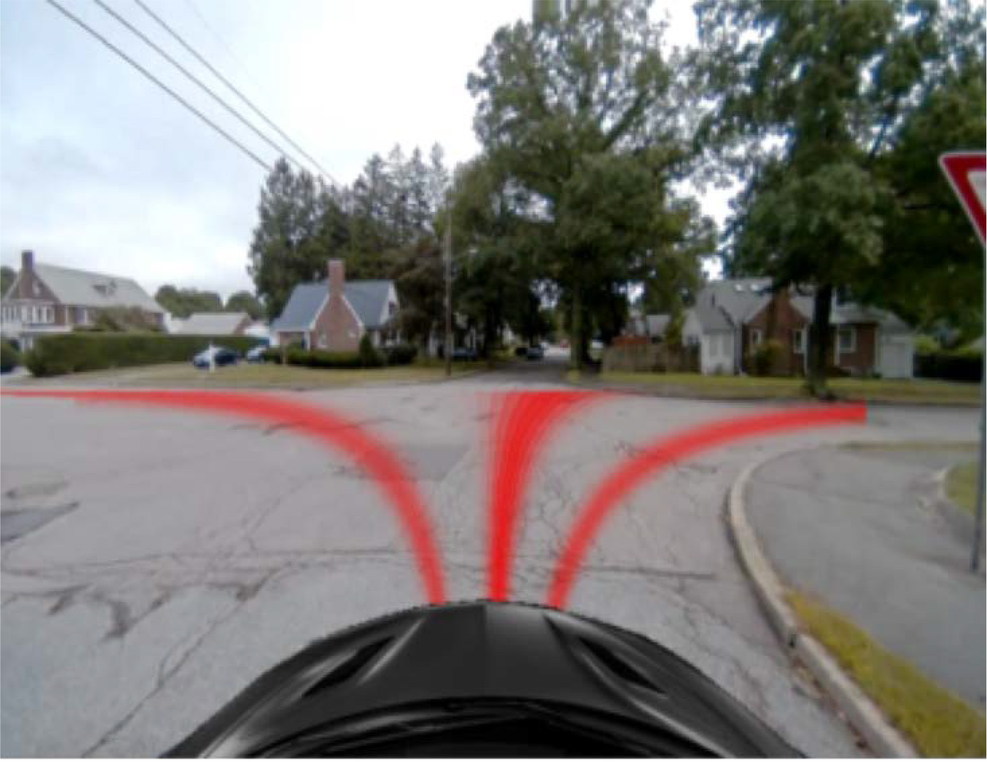
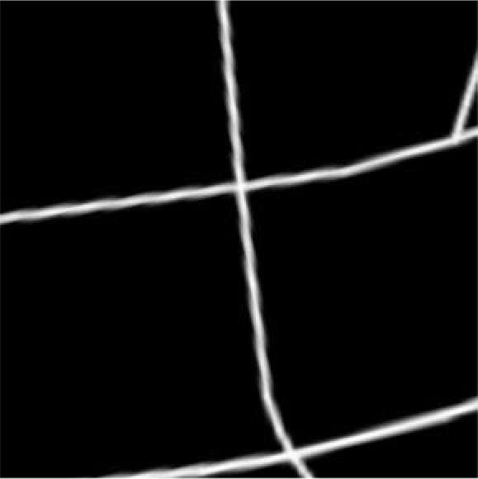
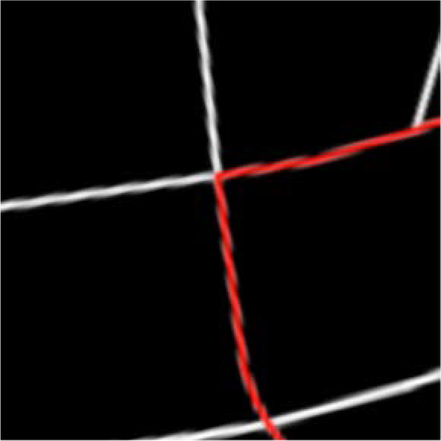

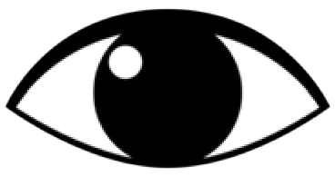
Self-Driving Cars: Navigation from Visual Perception
Possible Control Commands
Raw Perception I
(ex.camera)
Coarse Maps M
(ex.GPS)
Amini+ ICRA 2019

Slide 30
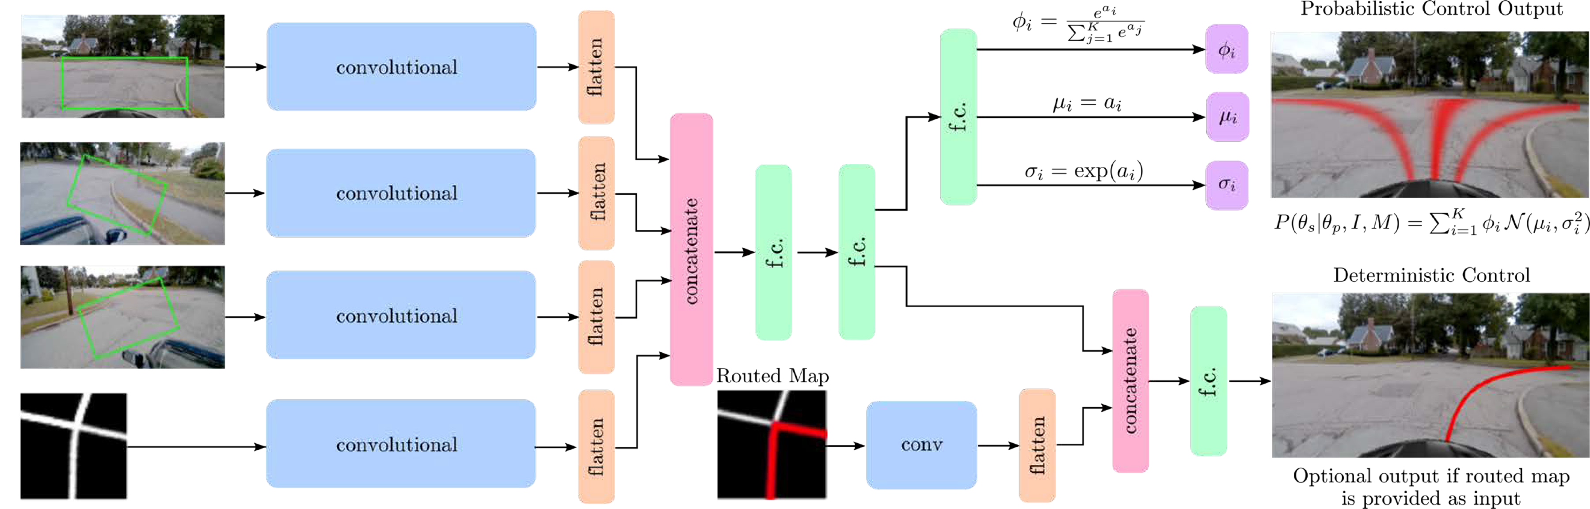
End-to-End Framework for Autonomous Navigation
Entire model trained end-to-end
without any human labelling or annotations
Amini+ ICRA 2019

Slide 31
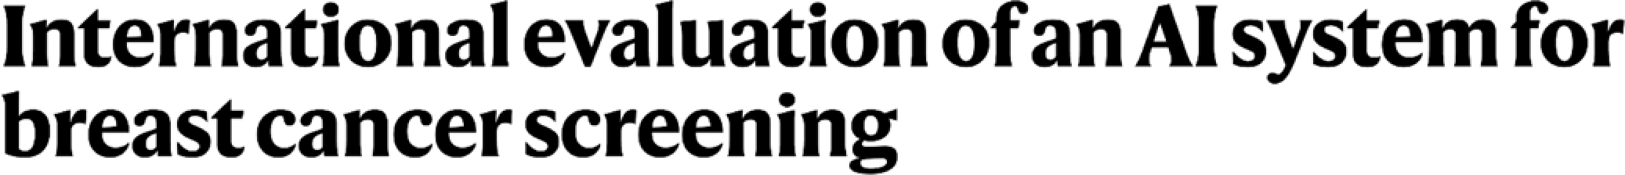
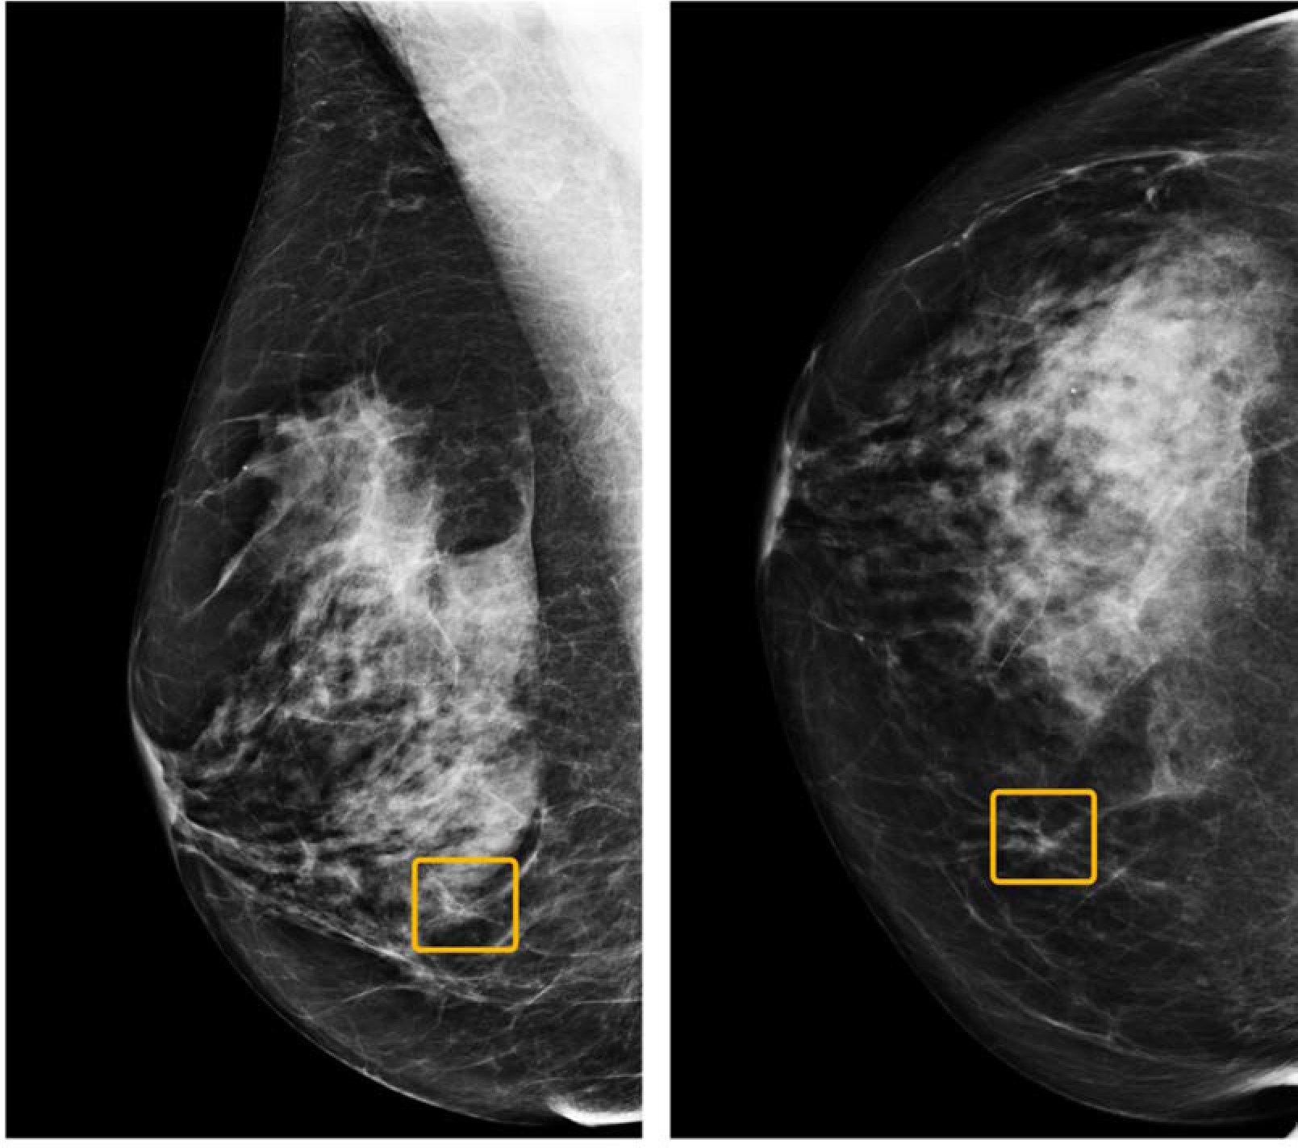
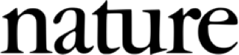
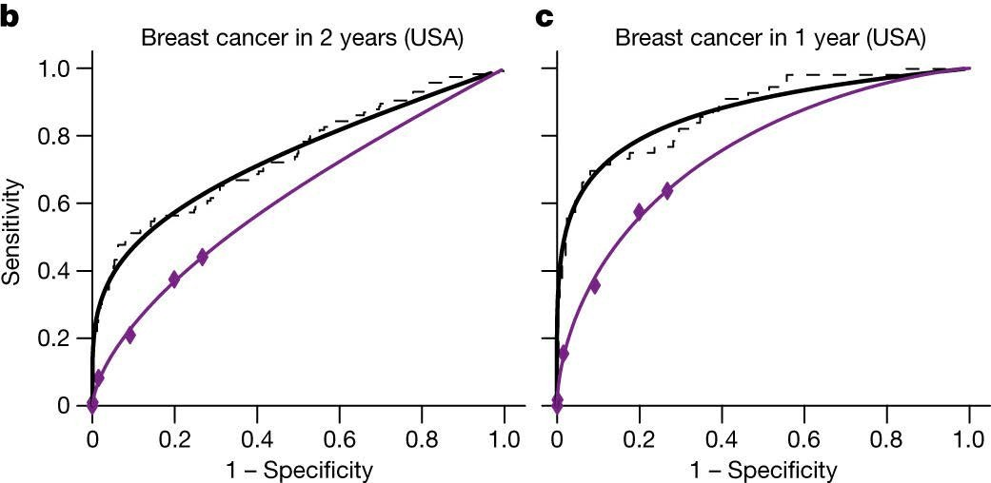
Breast Cancer Screening
₆.
AI MD
Readers
AI MD
Readers
CNN-based system outperformed expert radiologists at detecting breast cancer from mammograms
Breast cancer case missed by radiologist but detected by AI

Slide 32
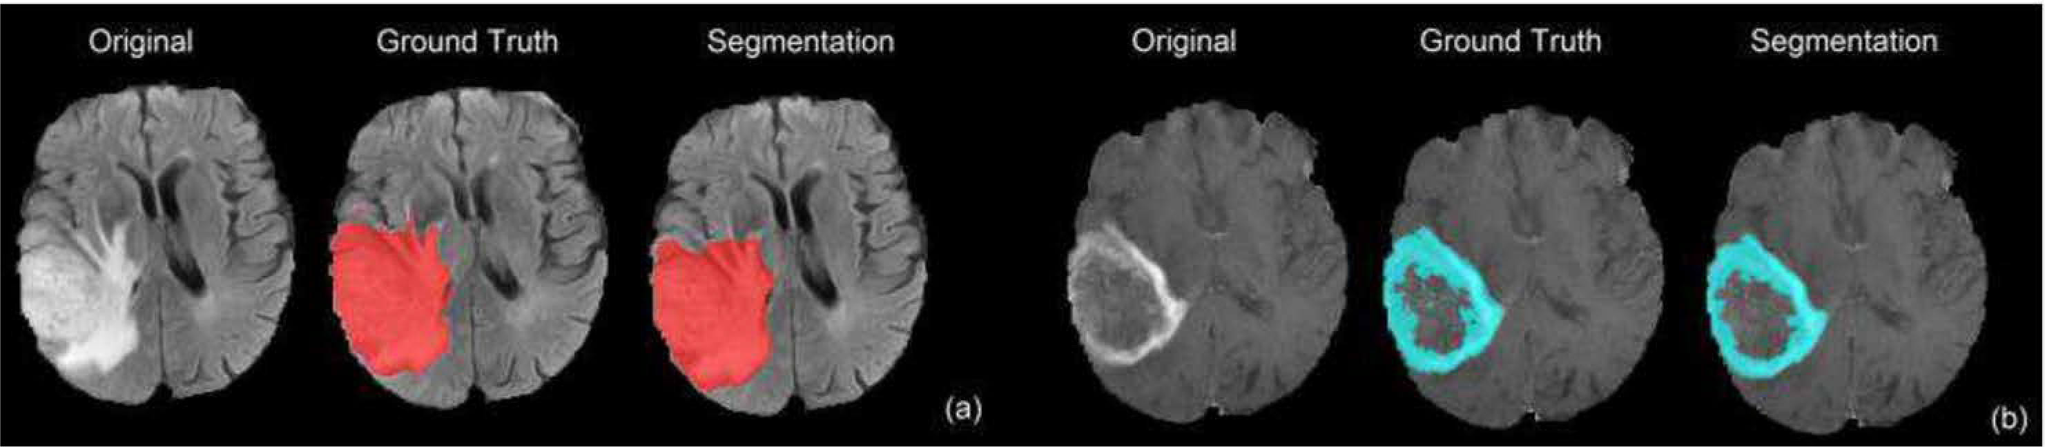
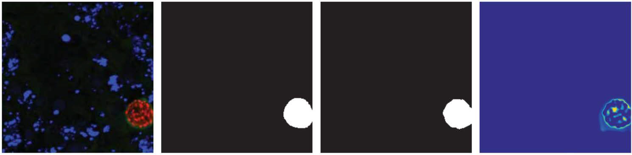
Semantic Segmentation: Biomedical Image Analysis
Brain Tumors Dong+ MIUA 2017.
Origi nal
Ground Truth
Segmenta tion
Uncertai nty
Malaria Infection Soleimany+ arXiv 2019.
Dong+ MIUA 2017; Soleimany+ arXiv 2019

Slide 33
Any Questions?
Sources:
http://introtodeeplearning.com/slides/6S191_MIT_DeepLearning_L1.pdf
https://cs231n.stanford.edu/slides/2023/lecture_5.pdf
https://elearning.di.unipi.it/pluginfile.php/16483/course/section/1837/l11-cnn.pdf
https://www.youtube.com/watch?v=JB8T_zN7ZC0

